Slide 1
Employee Data Analysis using Excel
STUDENT NAME: GNANASHREE N
REGISTER NO:312209681
DEPARTMENT:B.COM MARKETING MANAGEMENT
COLLEGE: ANNA ADARSH COLLEGE FOR WOMEN

Slide 2
PROJECT TITLE
Employee Performance Analysis using Excel:
SCORE BASED APPROACH

Slide 3


AGENDA
Problem Statement
Project Overview
End Users
Our Solution and Proposition
Dataset Description
Modelling Approach
Results and Discussion
Conclusion
3/21/2024 Annual Review

Slide 4

PROBLEM STATEMENT
To Analyse and optimize the performance of the employees by evaluating the key metrics such as emp id,employee ststus,employee level,performance level etc. the analysis aims to identify the employees with greater efficiencies.

Slide 5

PROJECT OVERVIEW
The prime objective is to create an employee performance analysis usingexcel with the help of various function such as conditional formatting, pivot table creation, graph etc...
.

Slide 6

WHO ARE THE END USERS?
Organization
Employers
Employees

Slide 7

OUR SOLUTION AND ITS VALUE PROPOSITION
Filtering: To find missing data
Graph: To get an graphical representation
Pivot table : To summarize the data
Conditional technique : Used to identify the missing data

Slide 8
Dataset Description
Employee dataset : Kaggle
Total: 26 features
Used : 9 features
Employee id
First name
Last name
Business unit
Employee type
Gender
Performance score
Current employee rating

Slide 9

THE "WOW" IN OUR SOLUTION
FORMULA:
=IF(Z37>=5,"VERY HIGH",IF(Z37>=4,"HIGH",IF(Z37>=3,"MED","LOW")))
This formula is used to find the performanace level of the employees which is delivered as “ medium,low and high”.And the performance level is used to get an graphical representation of the employee performance.
CONDITIONAL FORMATING:
The conditional formattings is used to identify the missing data in a cell , highlight the missing cells and also to remove the missing cell.
3/21/2024 Annual Review
9

Slide 10
MODELLING
DATA SCREENING : Downloaded an employee from Kaggle , and saved the dataset in an folder then insert the same in Excel.
DATA CLEANING : Using conditional formating from home identified and removed the missing data and selected 9 datas from [emp id,name,gender etc...]
DATA FORMULATING : Using “IF”Condition created an column of performance level using data from current employees ratingwhich gave an output as medium ,low,high.
PIVOT TABLE CREATION : Select pivot table from insert and an pivot table in enabled ,now select the required data . An pivot table isnow created, we shall also pivot table through Queries and Connection icon.
Graphical Representation: after creating an pivot table select the pivot table select the pivot table and go to insert icon and select recommendation chart and an visual representation is created.
10

Slide 11
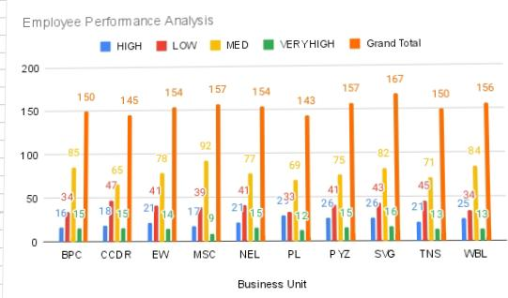
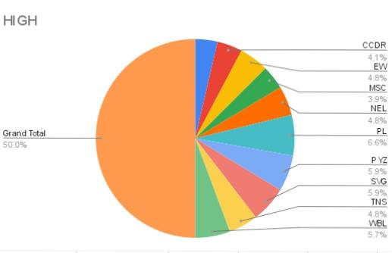
RESULTS
11

Slide 12
conclusion
The end output is created as employee performance analyses using various functions such as pivot table table ,graph etc . This helps to easily analyse the data . This performance analysis is used to find the employees to find the employees with the greater efficiency.

